Slide 1
Client Side Scripting
Introduction

Slide 2
Client Side Scripting
Client Side Scripting refers to computer web programs that are executed Client Side.
With Client Side Scripting source code is transferred from the web server to the users computer over the internet and run directly in the browser. In fact:
Client Side refers to execution over the user's web browser while
Server Side refers to execution over the web server.
The scripting language needs to be enabled on the client computer.

Slide 3
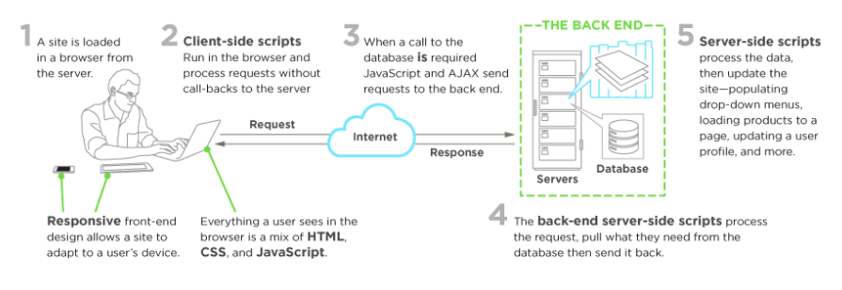
Client Side Scripting
Everything you see, click, and interact with on a website is the work of client side scripting (front-end web development).

Slide 4
Client Side Scripting
Websites run on three components:
The server: A remote location anywhere in the world. Functionalities include running a site’s back-end architecture, processing requests, and sending pages to the browser.
The database
The client: The browser a person is using to view a site. It’s where client-side technology is unpacked and processed. The client is anywhere your users are viewing your site: mobile devices, laptops, or desktop computers.

Slide 5
Client Side Scripting
There is overlap between Client Side and Server Side as they work as a pair, but there are differences.
Server-side scripting works in the back end of a site, which the user doesn’t see. It creates a scaffolding for the site to access its database, all the behind-the-scenes mechanics that organize and power a website.
Client-side code, however, handles what the user does see.

Slide 6
Client Side Scripting
Scripts are embedded within and interact with the HTML of your site:
Selecting elements of it
Manipulating those elements
Providing an interactive experience
Scripts also interact with a cascading style sheet (CSS) file that styles the way the page looks.
Scripts put less stress on the server because they don’t require processing on the server once they’re downloaded.

Slide 7
Client Side Scripting
The content of a web site can be classified as:
Static content – does not change regularly e.g. personal and professional web sites
Dynamic content – changes regularly depending on user input, environmental conditions or other variables e.g., newspaper web sites, weather report sites,
Client Side Scripting is an important part of the Dynamic web pages.
Client-side scripting is always evolving—it’s growing simpler, more agile, and easier to use. As a result, sites are faster, more efficient, and less work is left up to the server.

Slide 8
Role of a Front End Web Developer
A Client Side developer creates interaction and user experience with scripts embedded in a site’s HTML.
What a web user sees, clicks, or uses to input or retrieve information is the work of the client side developer.
Scripts are downloaded by the browser, processed, and then run apart from the server.
The focus is on user experience, and the technology they implement will effect how well the website accomplishes speed, efficiency, and smooth functionality.

Slide 9
Front End Web Developer
A front-end web developer’s services include:
Tailoring user experience
Bringing a designer’s concept to life with HTML, CSS, and JavaScript
Production, modification, and maintenance of websites and web application user interfaces
Creating tools that enhance how users see and interact with your site in any browser
Implementing responsive design for mobile sites
Contributing some back-end experience, collaborating on APIs, and more
Maintaining software workflow management with a project management tool like GitHub
Consulting on SEO (Search Engine Optimisation) best practices
Testing the site during development for usability and fixing any bugs

Slide 10
Client Side Languages
Popular client-side languages that front end developers use regularly
JavaScript: With its frameworks and libraries, it’s the core of front end development, and beyond. It was the first client side language and is still the most universal client-side script on the web.
HTML5: HTML dictates a site’s organization and content, all interaction aside, so it’s something every front-end developer needs to know. HTML elements can annotate footers, headers, how text displays, how media and images appear, and more.
CSS3: The latest standard for cascading style sheets (CSS), CSS3 is broken into modules and comprises the code for every graphic element—from backgrounds to font—that make up the look and feel of a website.
AJAX: JavaScript + XML, it allows specific parts of a site to be updated without a full-page refresh by asynchronously connecting to the database and pulling XML-based chunks of data.

Slide 11
Client Side Scripting
Everything on the front end is built with a mix of HTML, CSS, and client-side scripts like JavaScript.
We will start by revising HTML and CSS first.

Slide 12
References
WODEHOUSE, C. (2015, May 5). Front-End Web Development: Client-Side Scripting & User Experience. Retrieved from Upwork: https://www.upwork.com/hiring/development/how-scripting-languages-work/

